Slide 2
All ABOUT THE COMPETITION
Yas Marina Circuit, in collaboration with Abu Dhabi National Oil Company (ADNOC) , bring Yas in Schools, a youth-focused initiative that offers schools a pathway for project-based STEAM learning programmes. It aims to inspire and develop “The Engineers of the Future”, equipping them with 21st Century skills and developing their passion for STEAM subjects.
Students, aged 8 to 21 years old, work together in small enterprising teams. They design, innovate, manufacture, test and race small-scale model cars to compete in inter and external school competitions, while also providing teachers with exciting and easy-to-adopt themed programmes and resources for delivering a broad range of learning outcomes.

Slide 3
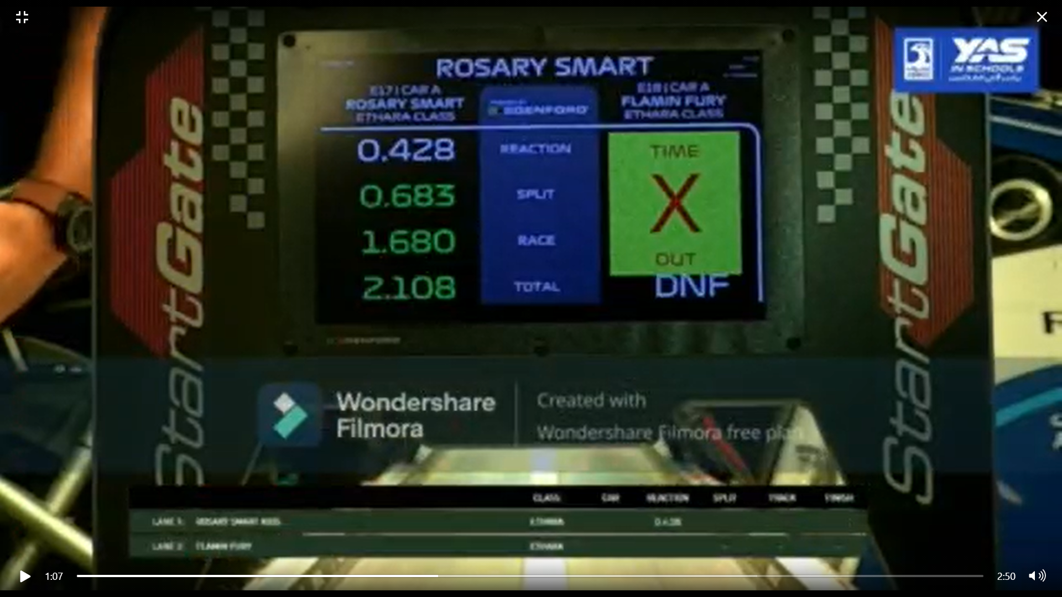
YOUNG TALENTS OF OUR SCHOOL
Glimpses
Of the
event!
Malak Khaaled - Year 11
Sedra Olimi - Year 11
Roula Elsayed – Year 6

Slide 4
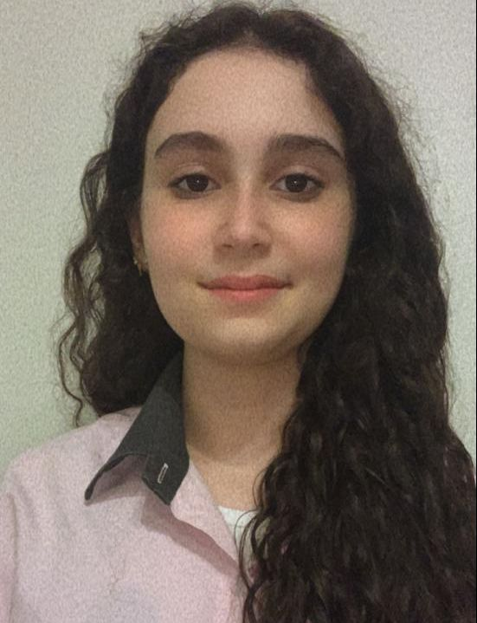
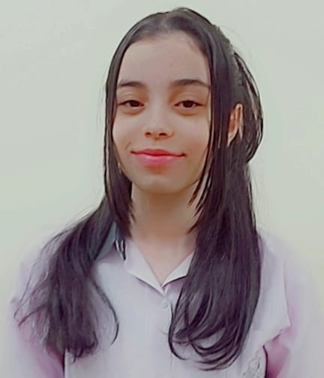
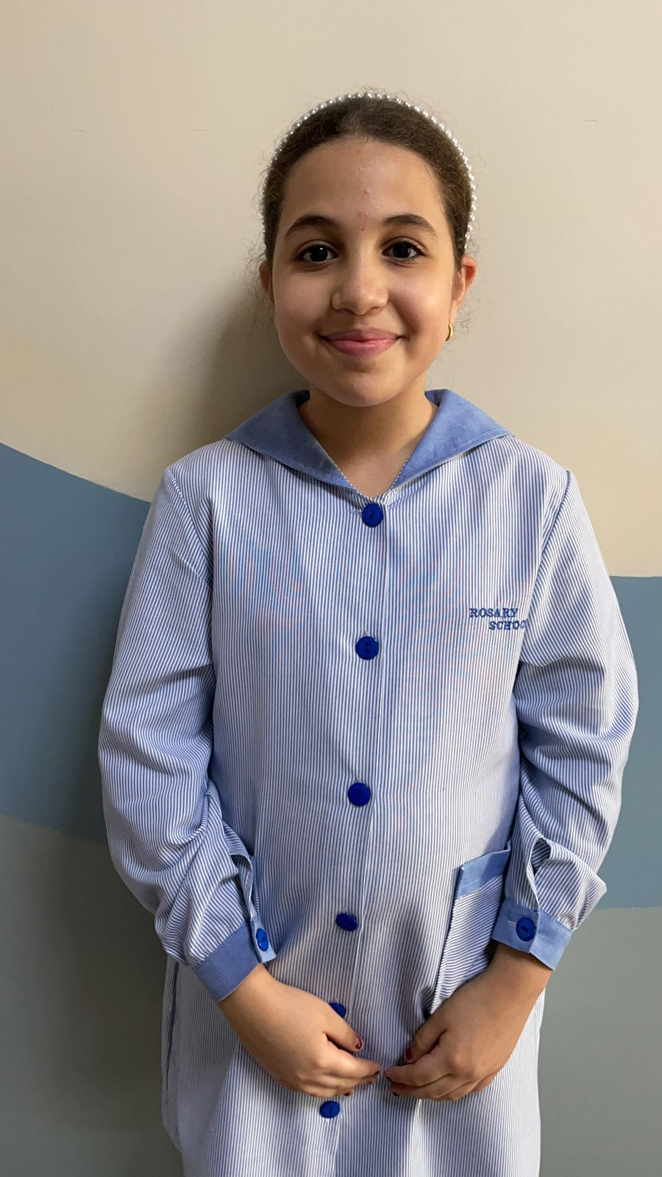
Malak Khaaled
Sedra Olimi
Roula Elsayed

